Slide 1
CCTV VIDEO OPTIMISATION
GROUP – 7

Slide 2
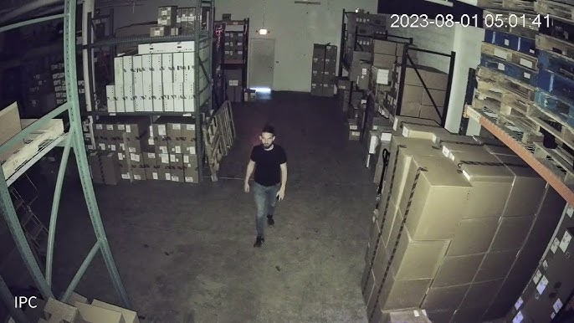
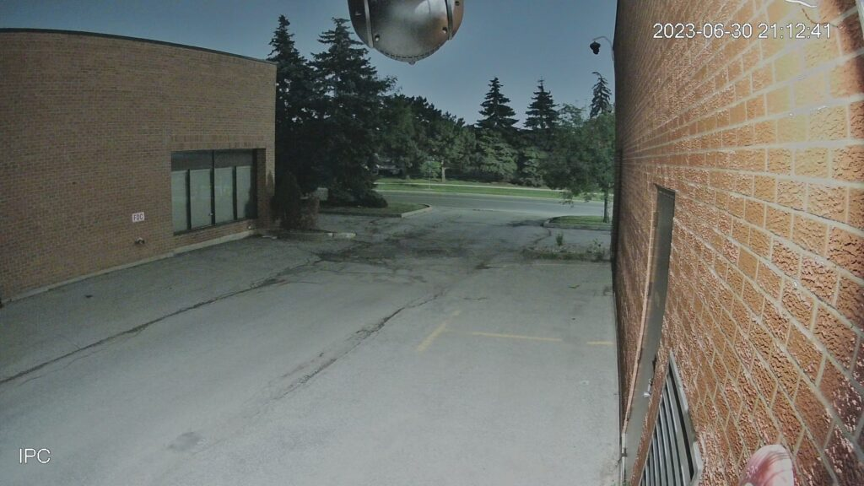
OBJECTIVE :
In growing surveillance technology the optimisation of video is highly required where we are able to optimise cctv footages without leaving out valuable information that is needed. Thus by deploying a deep learning-based solution that optimizes CCTV video storage by detecting human presence and preserving only frames with humans, effectively reducing storage space while ensuring relevant footage is retained.

Slide 3
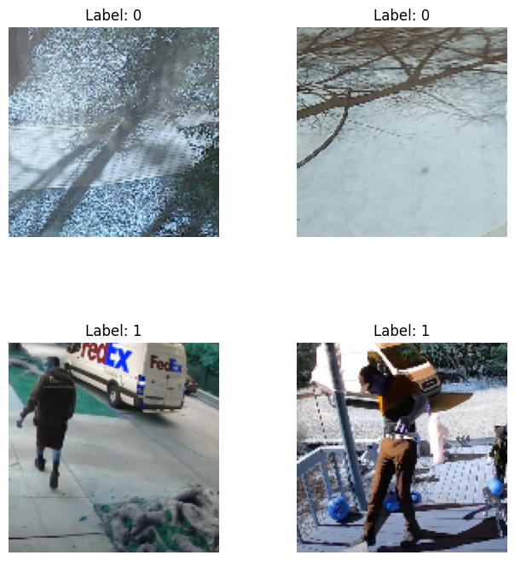
About the data:
https://www.kaggle.com/datasets/constantinwerner/human-detection-dataset/data
Labelled folders as 0 and 1.
0 – no human
1 – human detected

Slide 4
Preprocessing:
Data labelling: Gathered images from a human detection dataset, organized into categories: "No Humans" (0) and "Humans" (1).
Image Resizing: Each image was resized to a standard dimension of 128x128 pixels for uniform input into the model.
Normalization: Pixel values were scaled to a range between 0 and 1 to improve model convergence during training.
Data Augmentation: Techniques like rotation, shifting, zooming, shearing, and flipping were applied to expand the training set and improve model generalization.
Train-Test Split: The dataset was split into training (80%) and testing (20%) sets to evaluate the model’s performance.

Slide 5
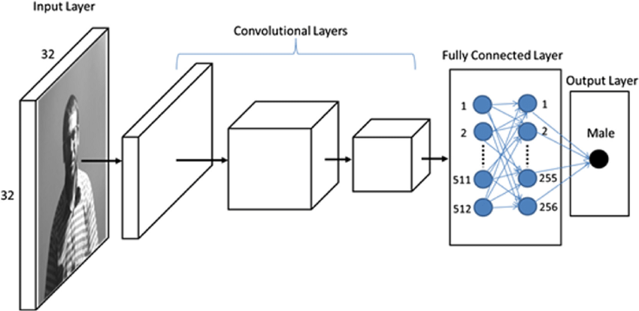
CNN Model creation:
Layers:
Conv2D + BatchNormalization + MaxPooling + Dropout
32 filters, 3x3 kernel, ReLU activation
MaxPooling with 2x2
Dropout at 30% for regularization
Conv2D + BatchNormalization + MaxPooling + Dropout
64 filters, 3x3 kernel, ReLU activation
MaxPooling with 2x2
Dropout at 30% for regularization
Conv2D + BatchNormalization + MaxPooling + Dropout
128 filters, 3x3 kernel, ReLU activation
MaxPooling with 2x2
Dropout at 30%
Conv2D + BatchNormalization + MaxPooling + Dropout
256 filters, 3x3 kernel, ReLU activation
MaxPooling with 2x2
Dropout at 30%
Fully Connected Layer (Dense)
128 neurons, ReLU activation, Dropout 50% for regularization
Output Layer
1 neuron, Sigmoid activation (binary output for human/no human)

Slide 6
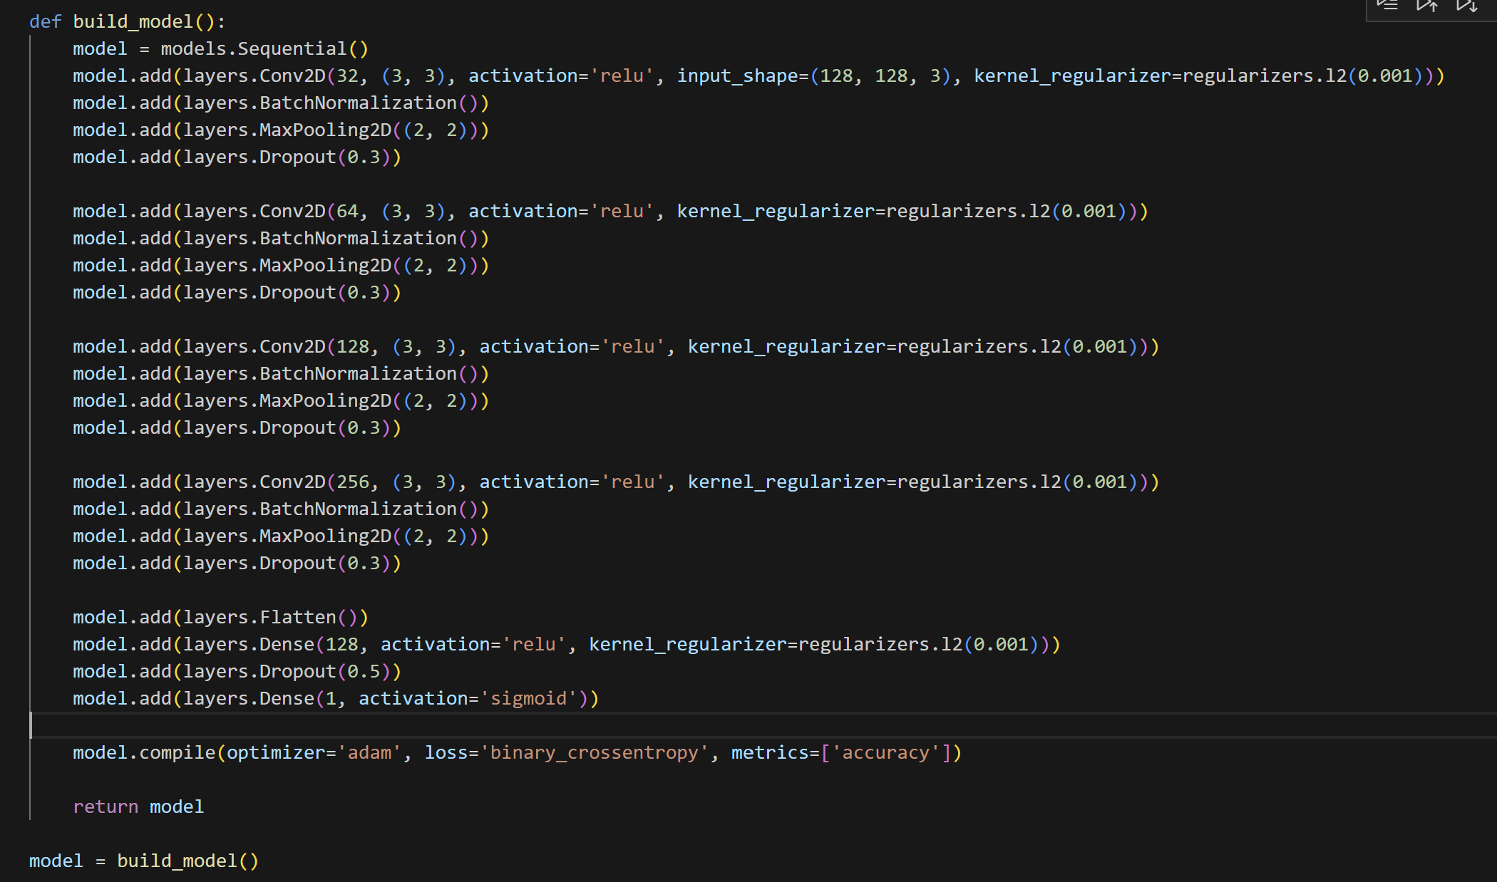

Slide 7
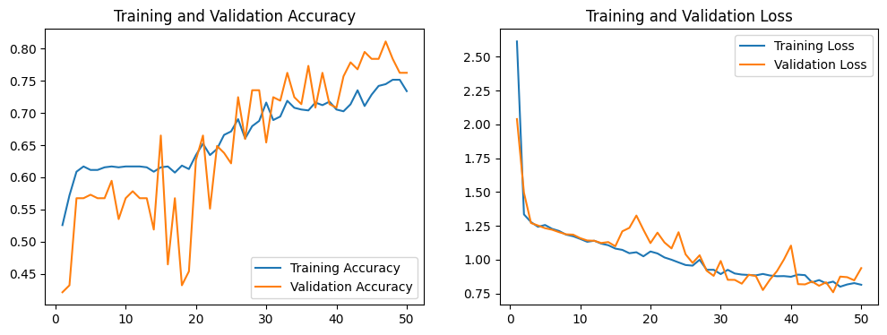
ACCURACY AND LOSS

Slide 8
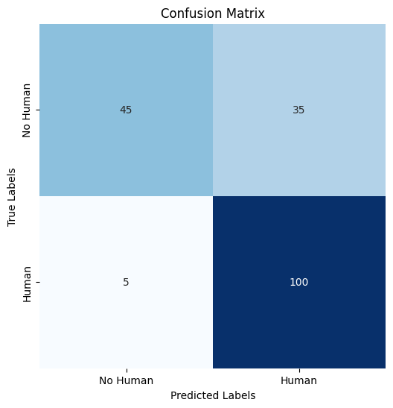
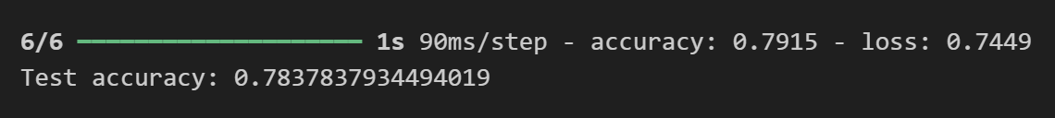
TESTING ACCURACY:

Slide 9
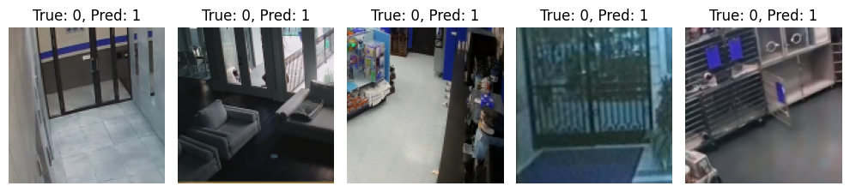
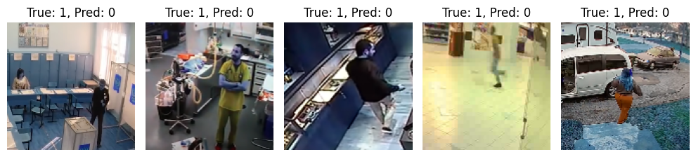
ERROR:

Slide 10
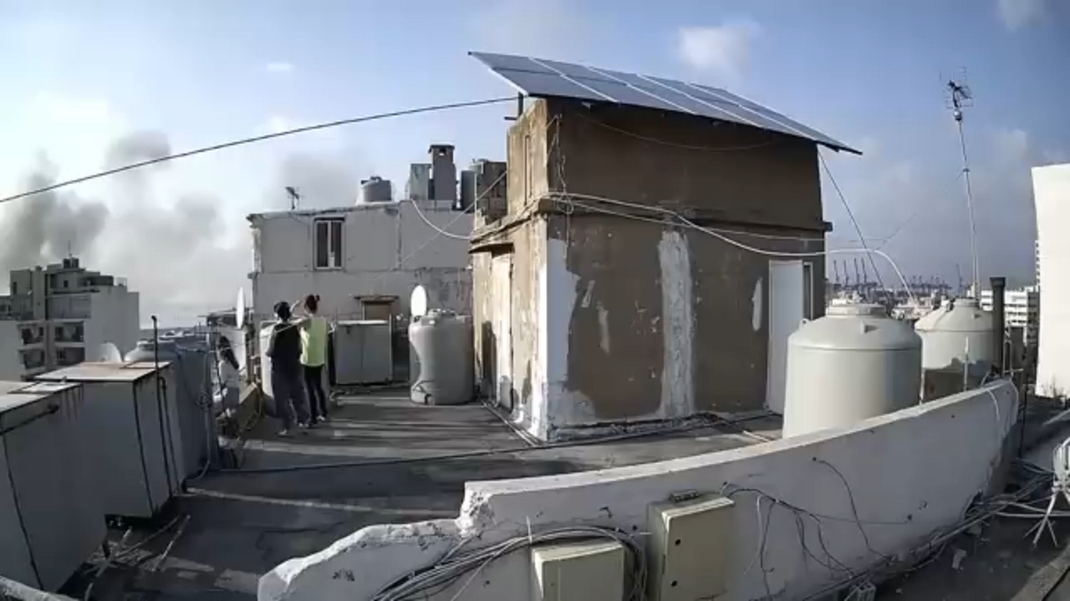
TESTING ON DIFFERENT DATA:
INPUT:

Slide 11
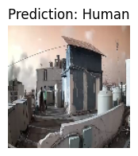
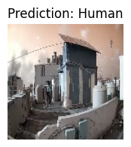
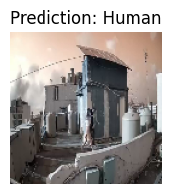
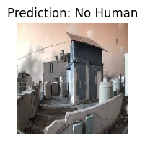
MODEL ON DATA

Slide 12

OUTPUT:

